Slide 1
Model S and R Comparison

Slide 2
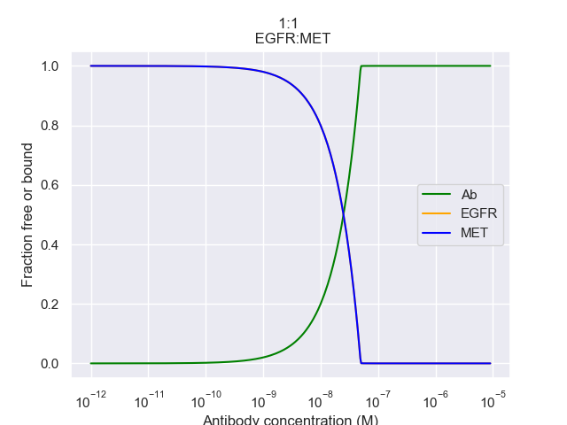
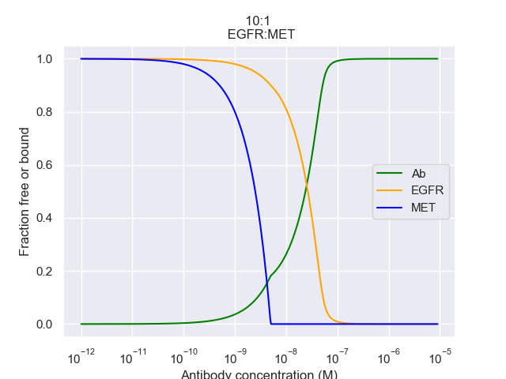
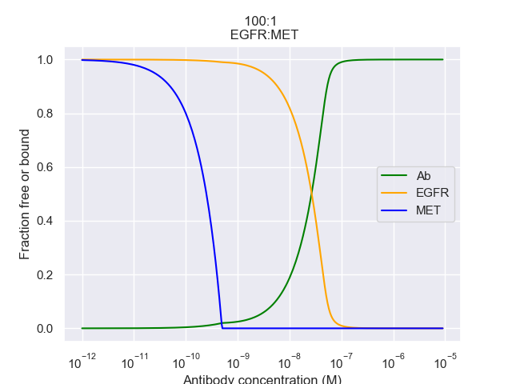
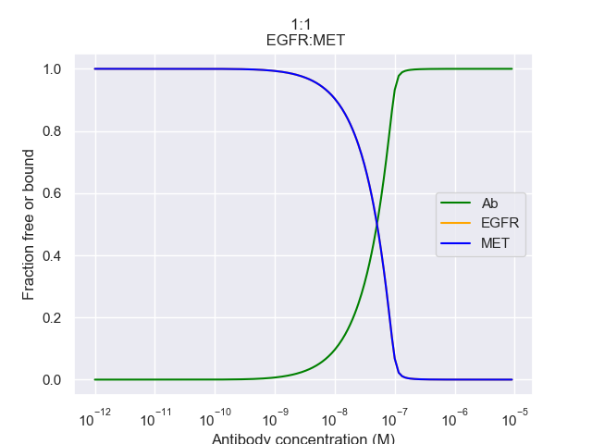
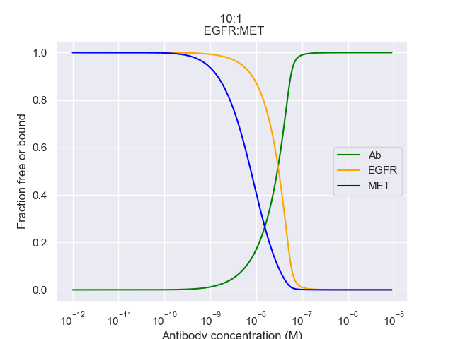

Model S:
Model R:

Slide 3
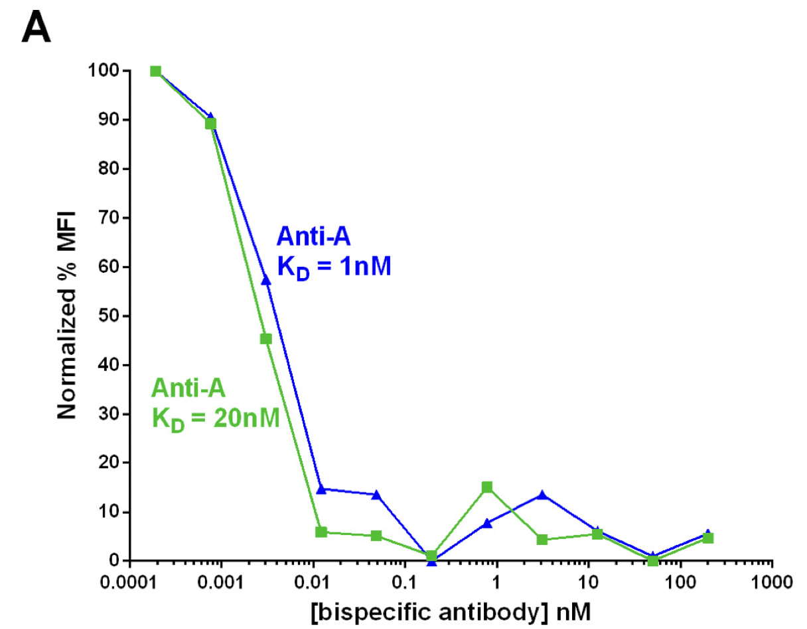
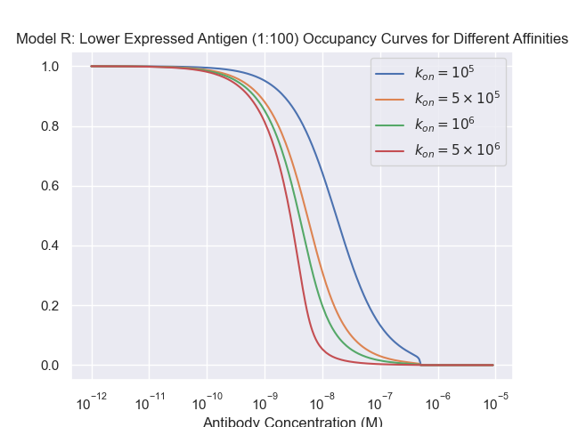
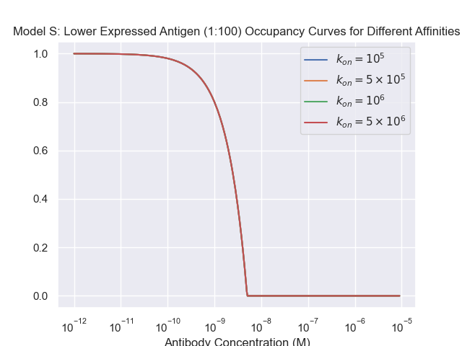

Slide 4
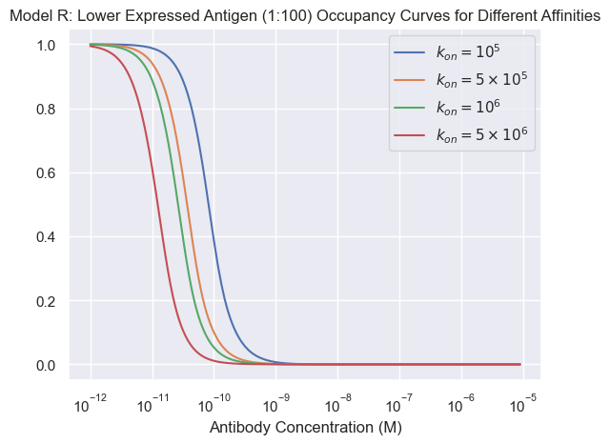
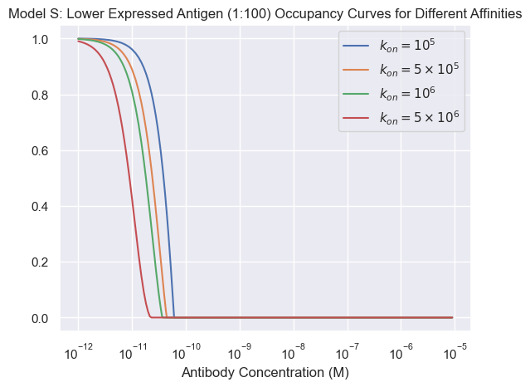

Slide 5
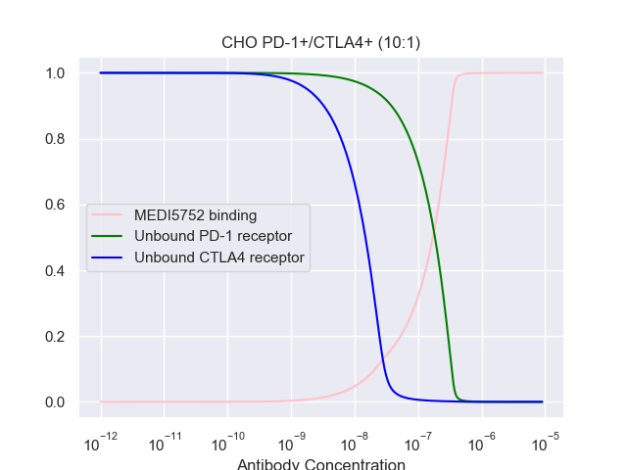
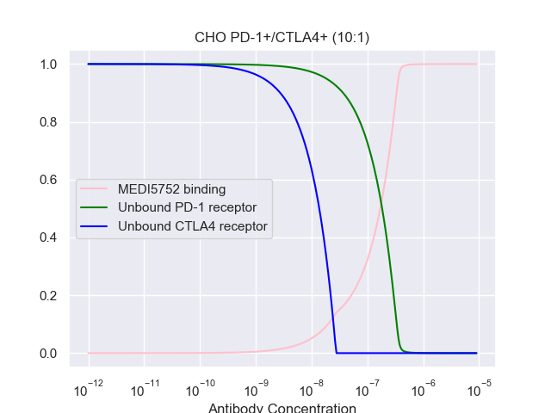
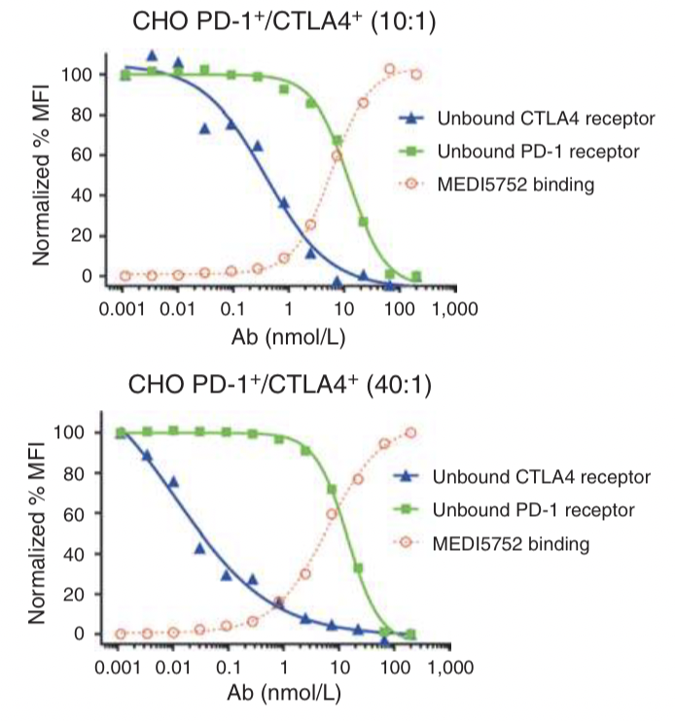
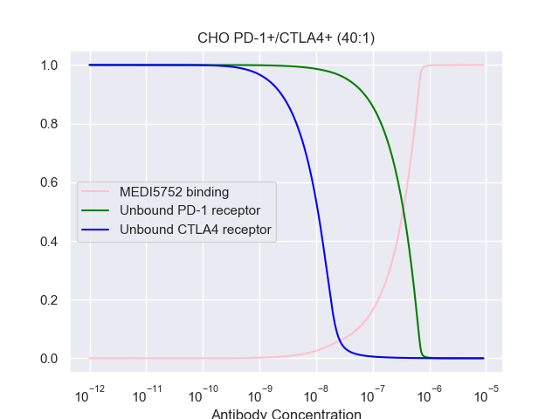
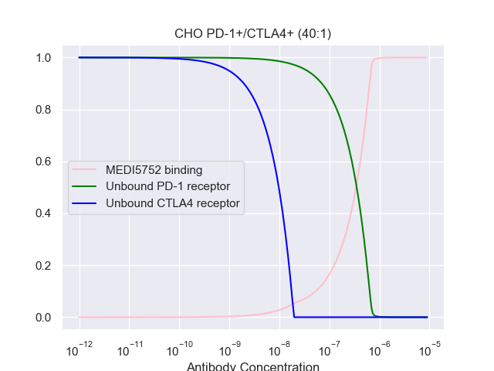
Design and efficacy of a monovalent bispecifc PD-1/CTLA4 antibody that enhances
CTLA4 blockade on PD-1+ activated T cells
MODEL R
MODEL S

Slide 6
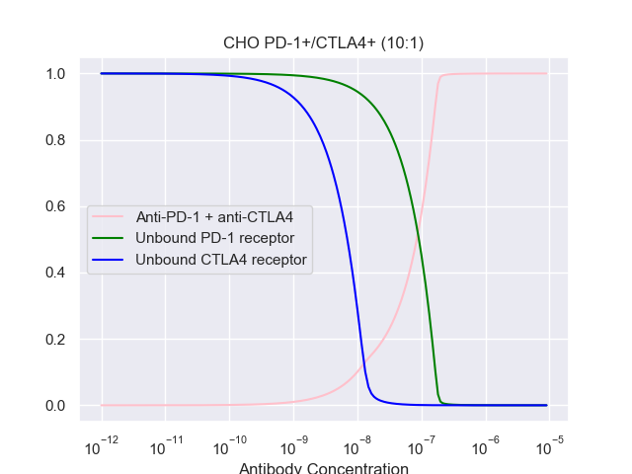
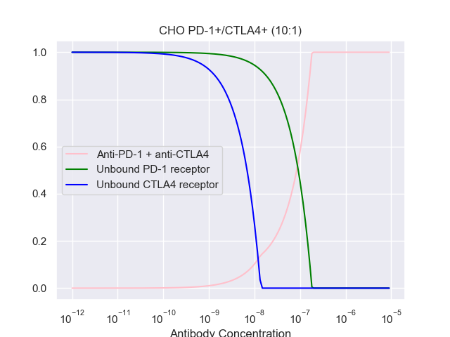
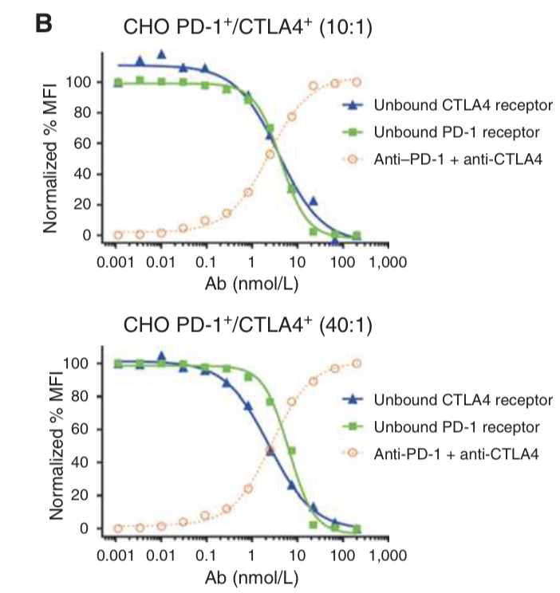
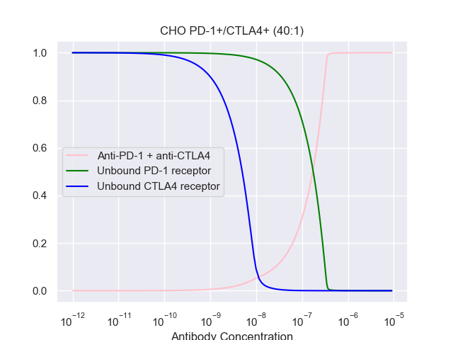

MODEL R
MODEL S

Slide 7
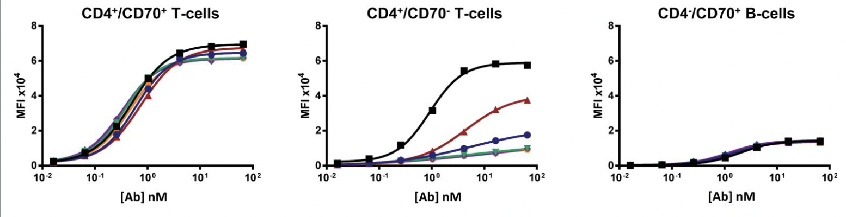
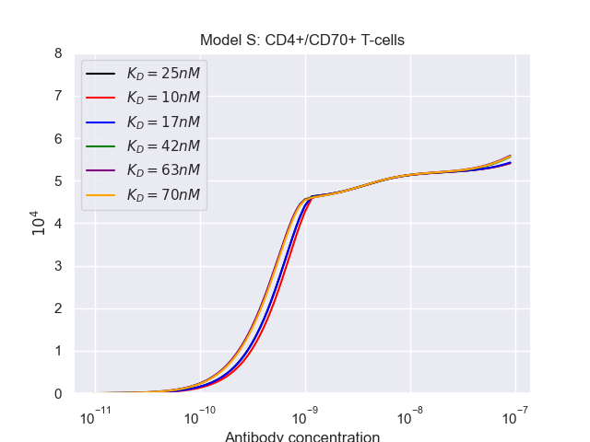
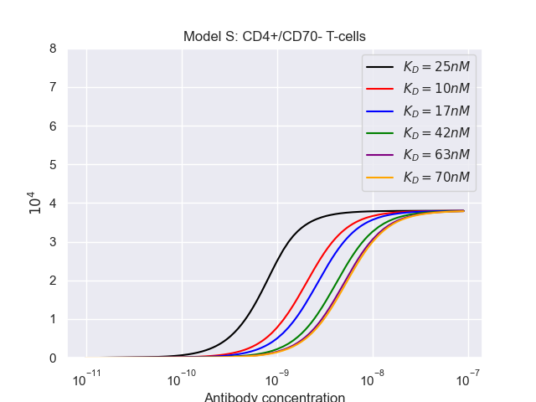
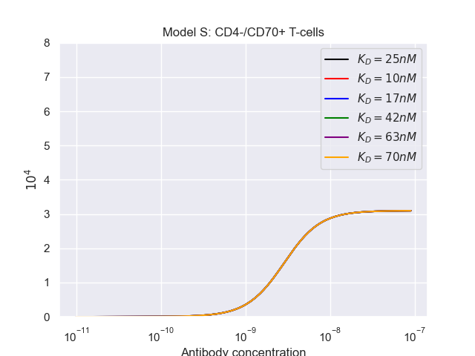
Bispecific Antibodies Used

Slide 8
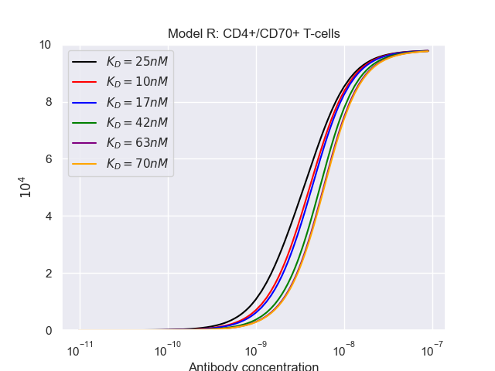
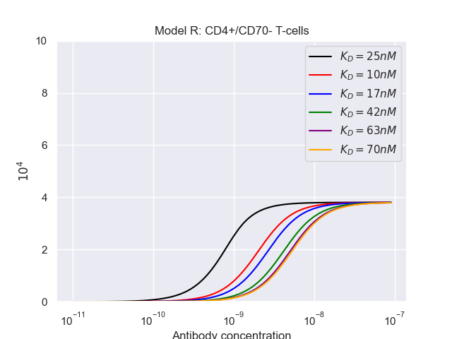
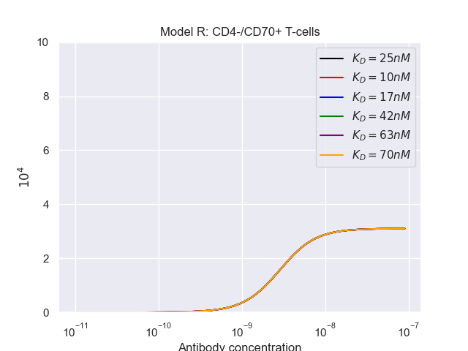

Slide 9
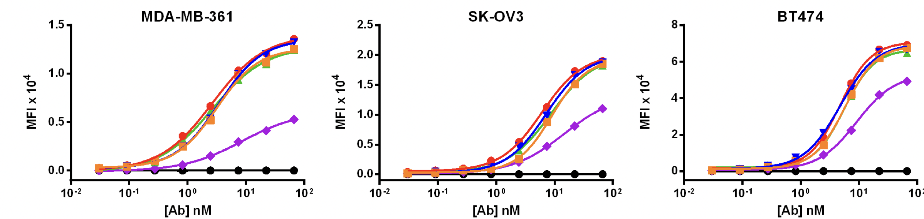
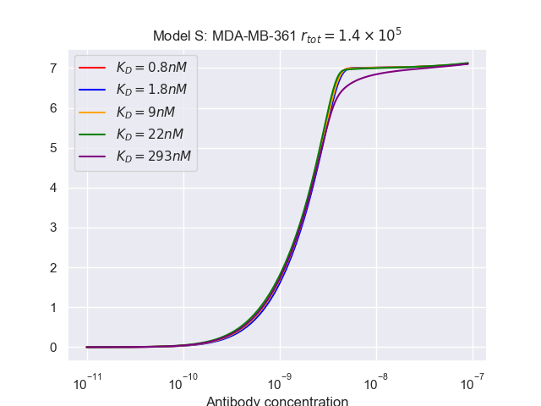
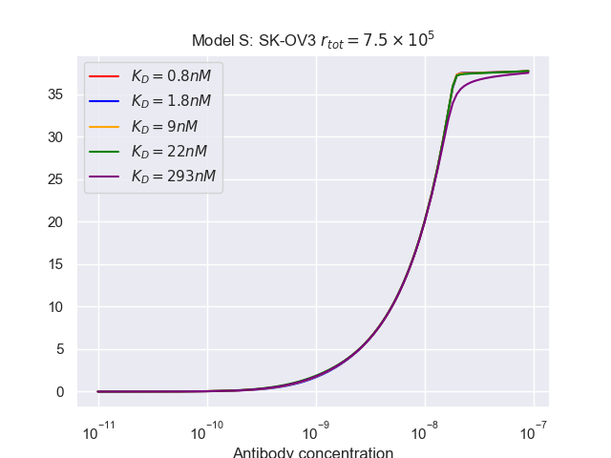
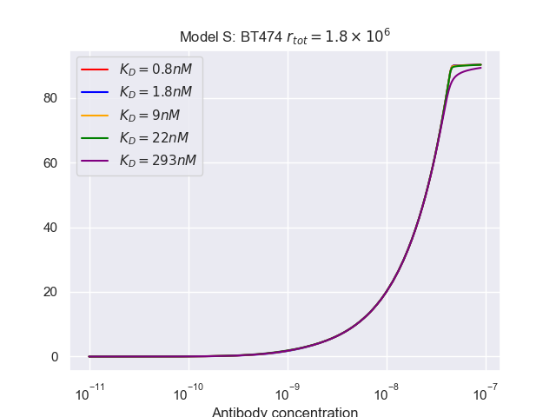
Monospecific Antibodies Used

Slide 10
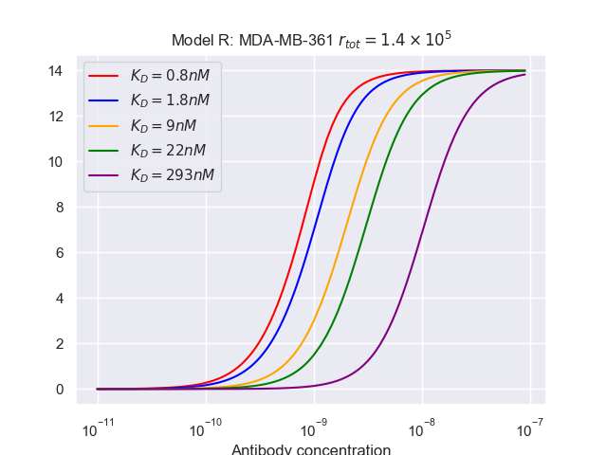
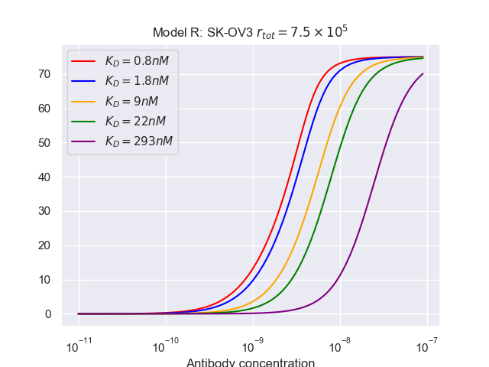
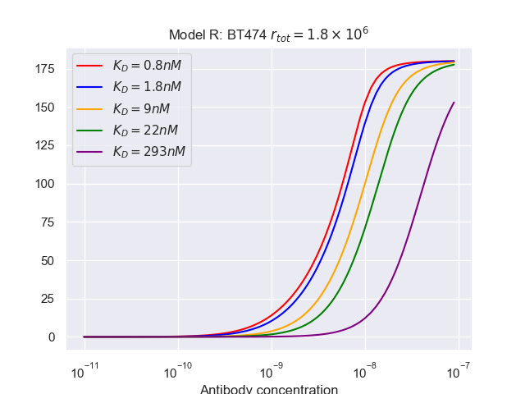

Slide 11
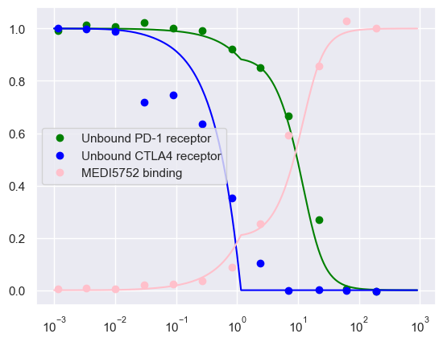
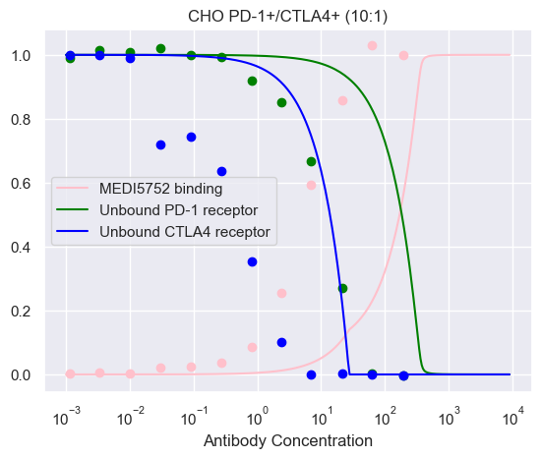
Model S
Parameter | Experimental/calculated value | Fitted
Rtot_pd1 | 7.3e5 | 4.7e6
Rtot_ctla4 | 5.5e4 | 5.6e5
Kon_pd1 | 2.95e5 | 2.3e6
Kon_ctla4 | 6.84e5 | 1.5e4
K2_pd1 | 7.7e4 | 1e5
K2_ctla4 | 8.3e4 | 7.3e6
Koff_pd1 | 2.36e-4 | 1.4e-2
Koff_ctla4 | 2.88e-4 | 1.1e-2
factor | 1 | 243

Slide 12
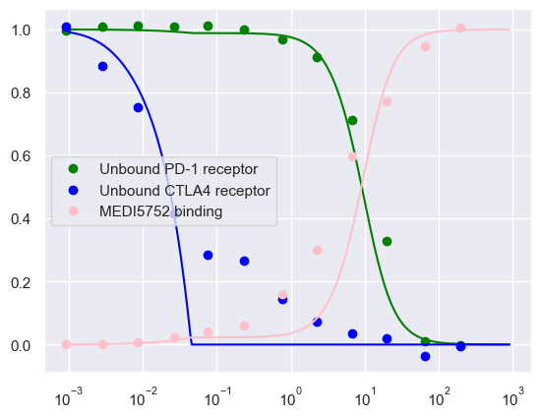
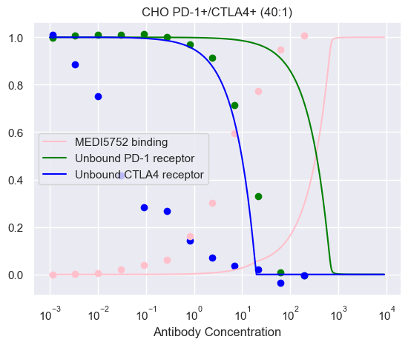
Model S
Parameter | Experimental/calculated value | Fitted
Rtot_pd1 | 1.4e6 | 3.5e6
Rtot_ctla4 | 3.9e4 | 4.1e4
Kon_pd1 | 2.95e5 | 5.3e6
Kon_ctla4 | 6.84e5 | 9.1e6
K2_pd1 | 7.7e4 | 2.3e6
K2_ctla4 | 8.3e4 | 9.8e6
Koff_pd1 | 2.36e-4 | 8.8e-2
Koff_ctla4 | 2.88e-4 | 2.7e-4
factor | 1 | 453

Slide 13
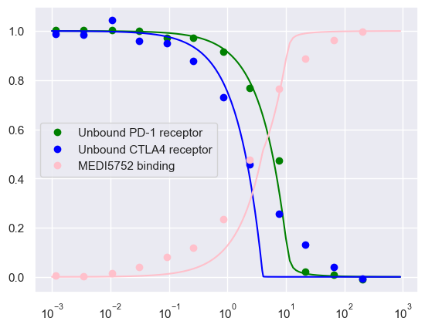
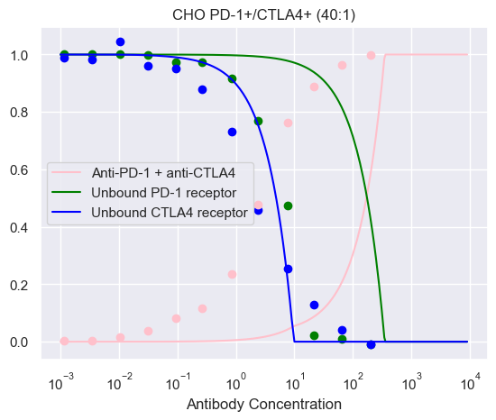
Model S
Parameter | Experimental/calculated value | Fitted
Rtot_pd1 | 1.4e6 | 1e5
Rtot_ctla4 | 3.9e4 | 3.5e4
Kon_pd1 | 2.95e5 | 3e6
Kon_ctla4 | 6.84e5 | 5.7e6
K2_pd1 | 7.7e4 | 1e3
K2_ctla4 | 8.3e4 | 9.8e6
Koff_pd1 | 2.36e-4 | 9.9e-2
Koff_ctla4 | 2.88e-4 | 8.5e-2
Factor_pd1 | 1 | 2.16
Factor_ctla4 | 1 | 2.16

Slide 14
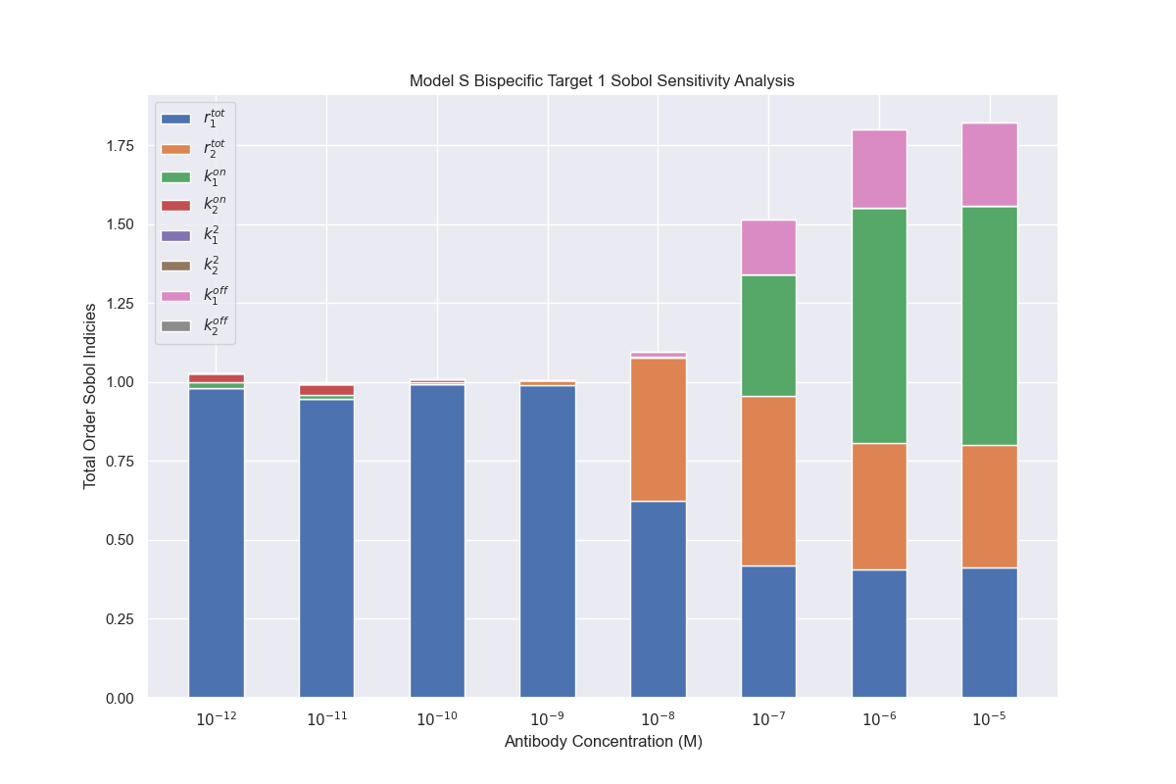
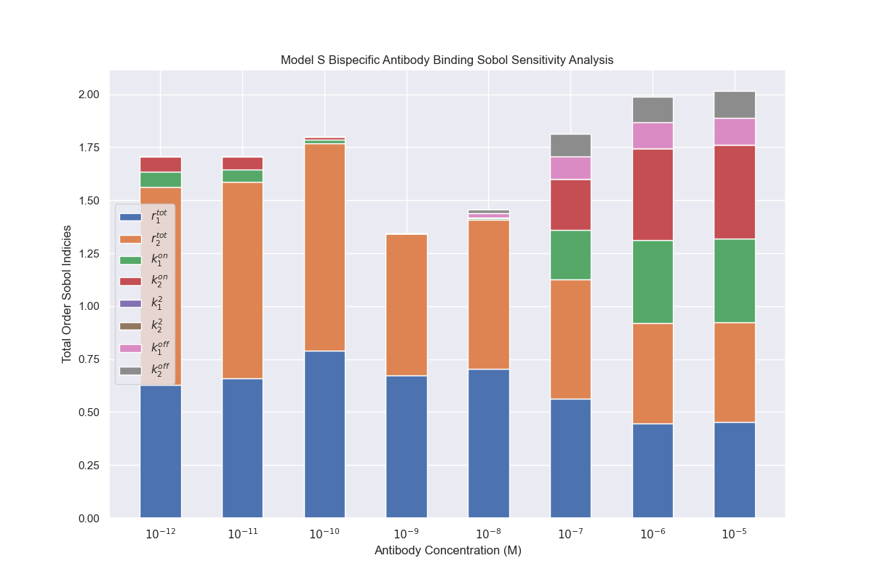
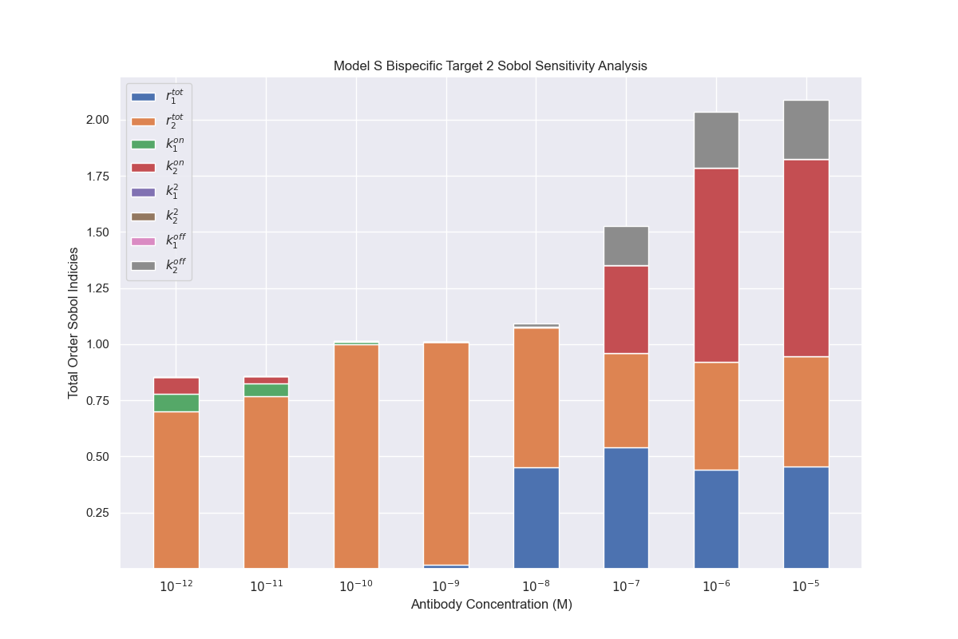
Model S bispecific antibody single cell total order indices

Slide 15
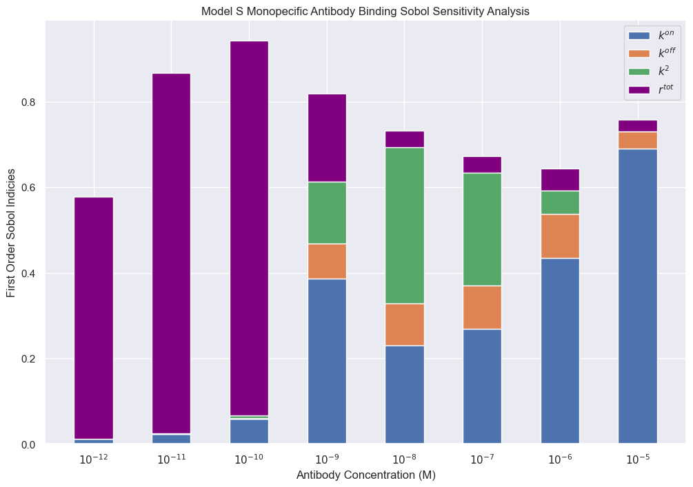
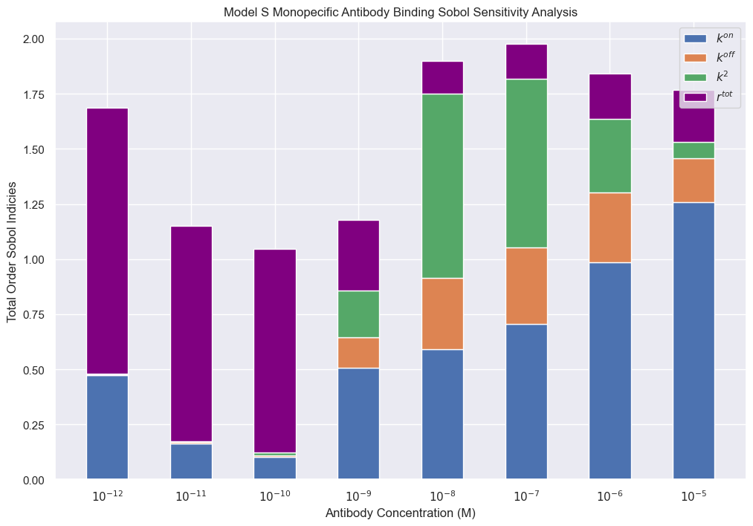
Model S monosepcific antibody first and total order indices

Slide 16
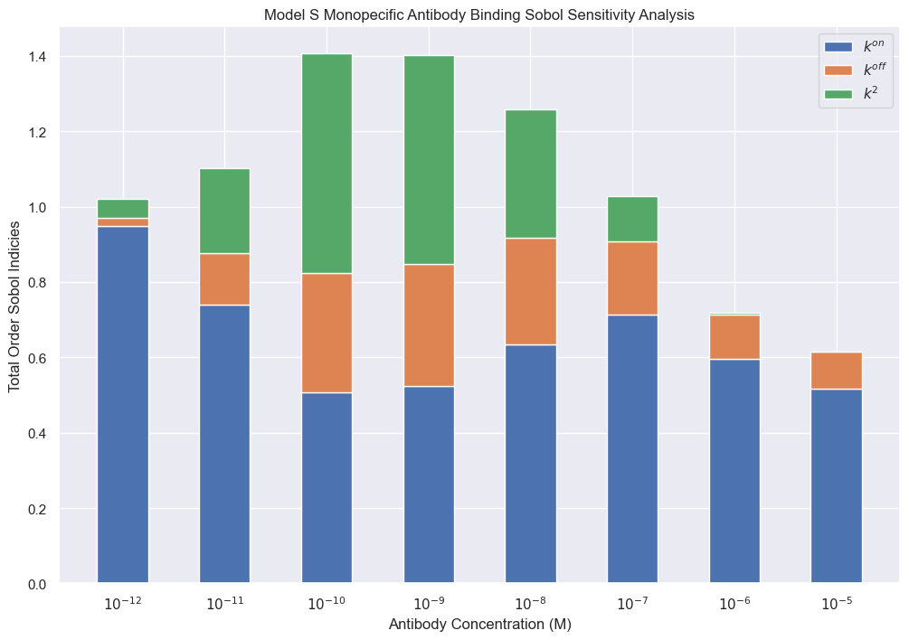
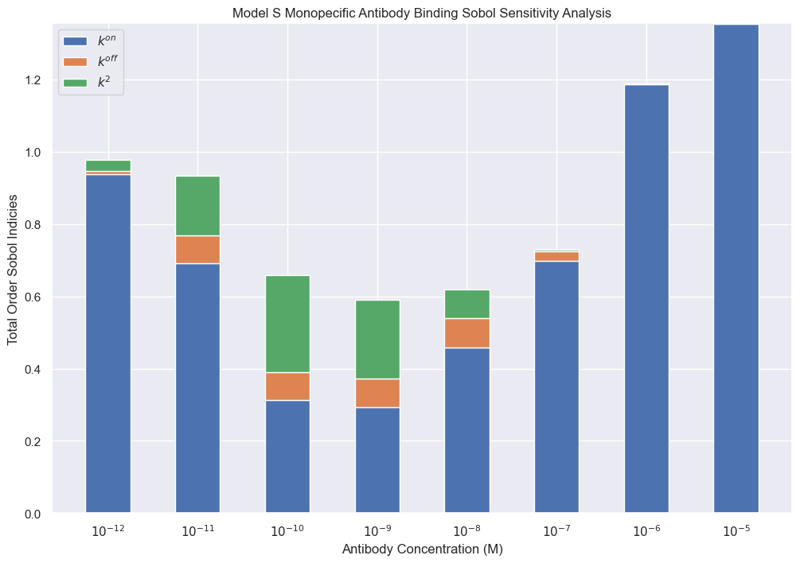
Model S monosepcific antibody first and total order indices with rtot = 1000

Slide 17
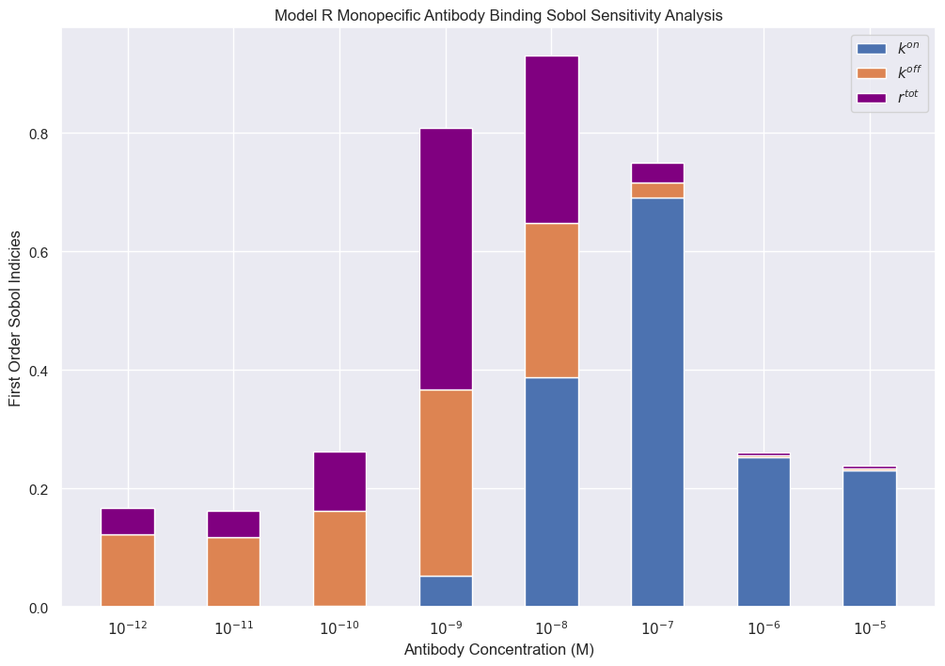
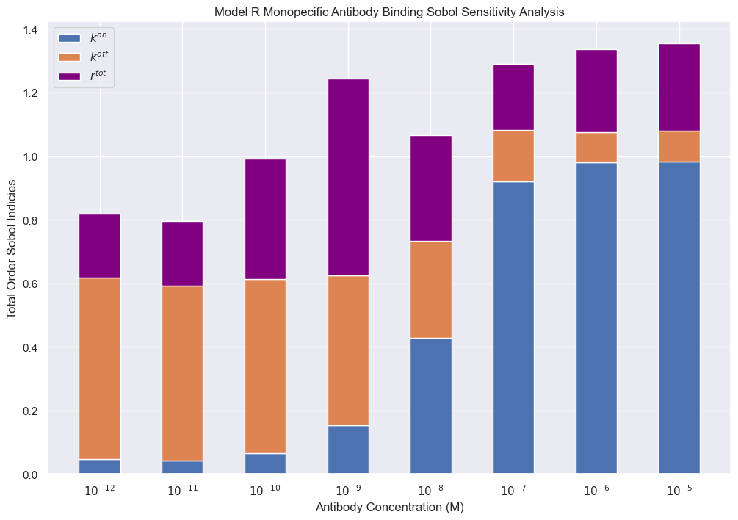
Model R sensiv analysis

Slide 18
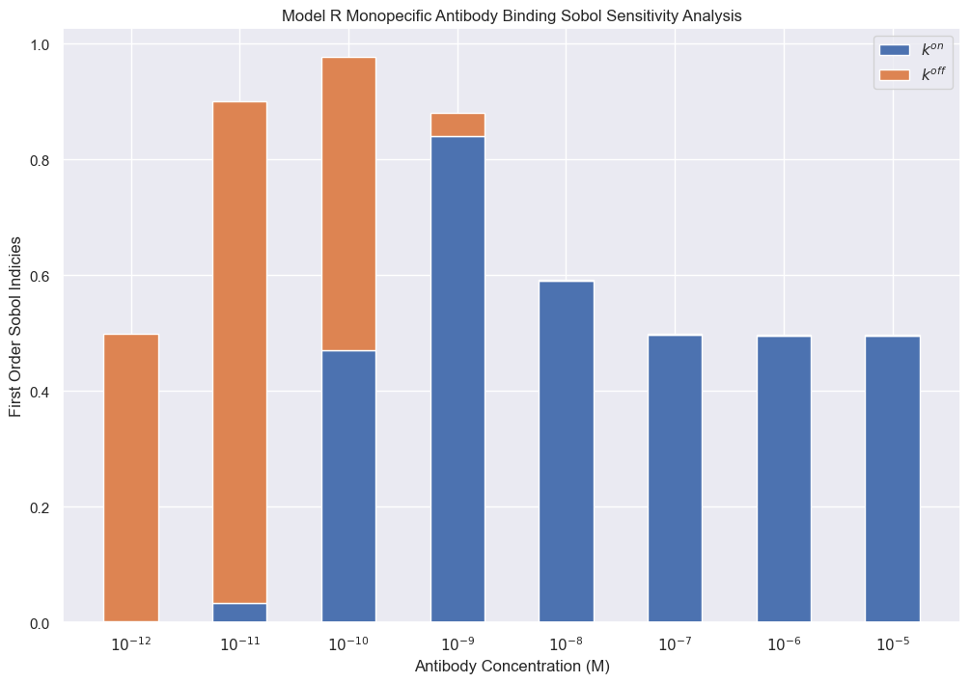
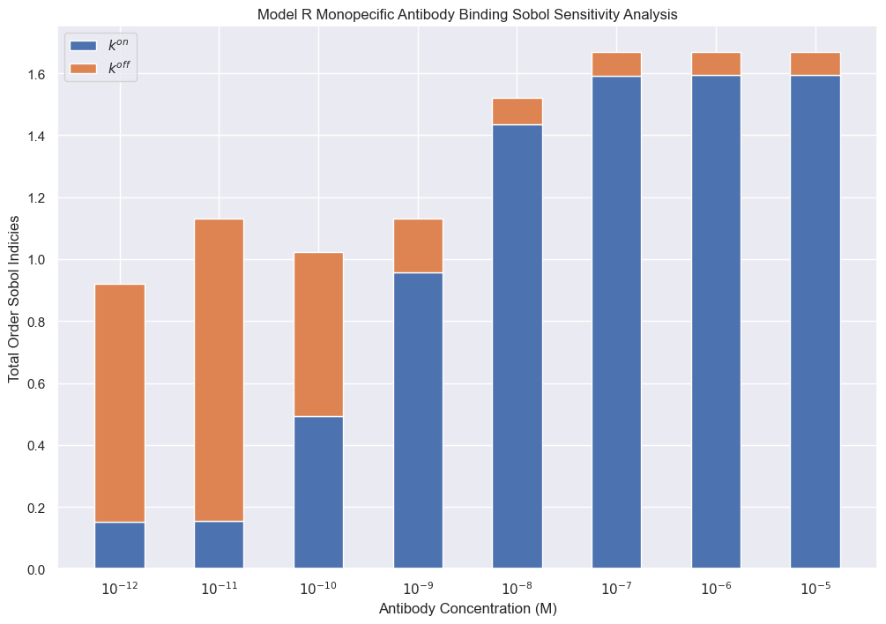
Model R sensitivity analysis with rtot=1000

Slide 19
Model R: Sensitivity analysis for number of antibody bound

Slide 20
Model S: sensitivity analysis for bound ab

Slide 21
Identifiability Analysis
Model S monospecific identifiability equations
Model S bispecific identifiability equations

Slide 22



Improved Fits

Slide 23


Improved Fits With Enforced Parameter Relations
Rtot1 set as 40xRtot2
Without enforcement

Slide 24

Fits With Varying KD
Original Simulation
Fitted Simulation

Slide 25

Kon fixed, listed koff used as initial guess
Kd (nM) | rtot | Kon (Ms)^-1 | K2(s^-1) | Koff(s^-1)
293 | 3496.20749 | 310000 | 213.564668 | 3.4885e-04
22 | 11985.3852 | 260000 | 5.68611456 | 0.55495448
9 | 12405.7860 | 300000 | 8.33854145 | 0.72857577
1.8 | 13373.2305 | 380000 | 8.69676628 | 0.62738771
0.8 | 13402.2044 | 330000 | 11.5600373 | 0.88968497

Slide 26
Different Asymptotic cases

Slide 27


Case 1:

Slide 28



Slide 29


Slide 30


Case2:
Case 1
Case 2

Slide 31



Slide 32



